Slide 1
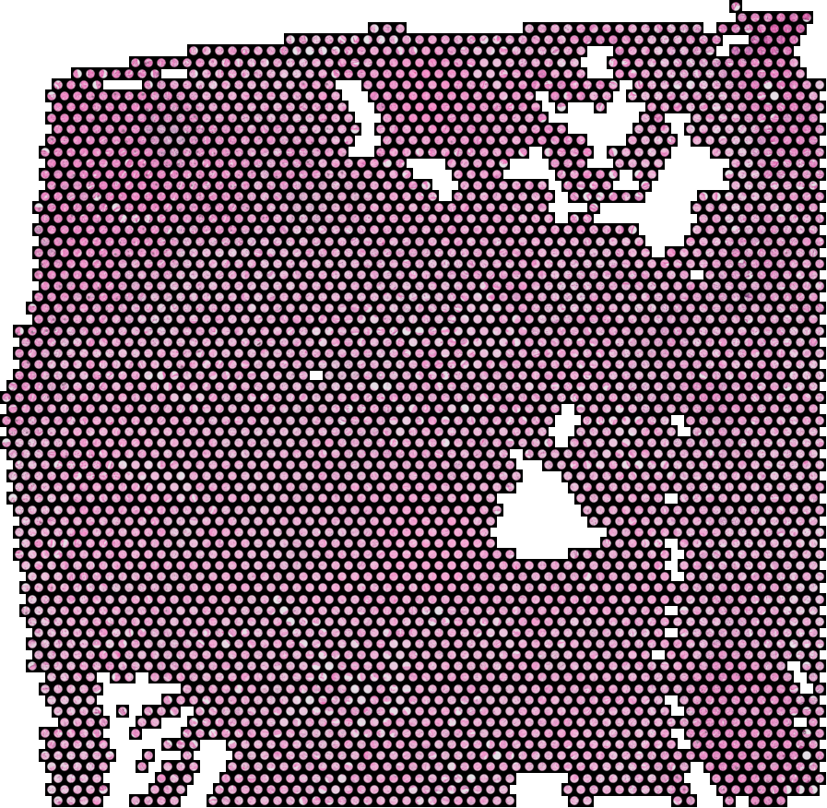
SPATIAL TRANSCRIPTOMICS RESEARCH
What can a routine slide
really tell us about
pancreatic cancer spread?
Fifteen questions, asked in order, each one because of the answer before it
Two cohorts · 73 sections · 25 patients · 201,000 measured spots
Research Advisors: Dr. Ashiq Masood and Dr. Mohsin Bilal
Notes:
I have organised this as a chain of questions rather than a list of results, because that is genuinely how it went. Every question here exists because of the answer to the one before it, so the order is not a filing system, it is the reasoning. I will put the question up first, then the evidence that settles it, and I will tell you plainly whenever the answer turned out to be no.

Slide 2
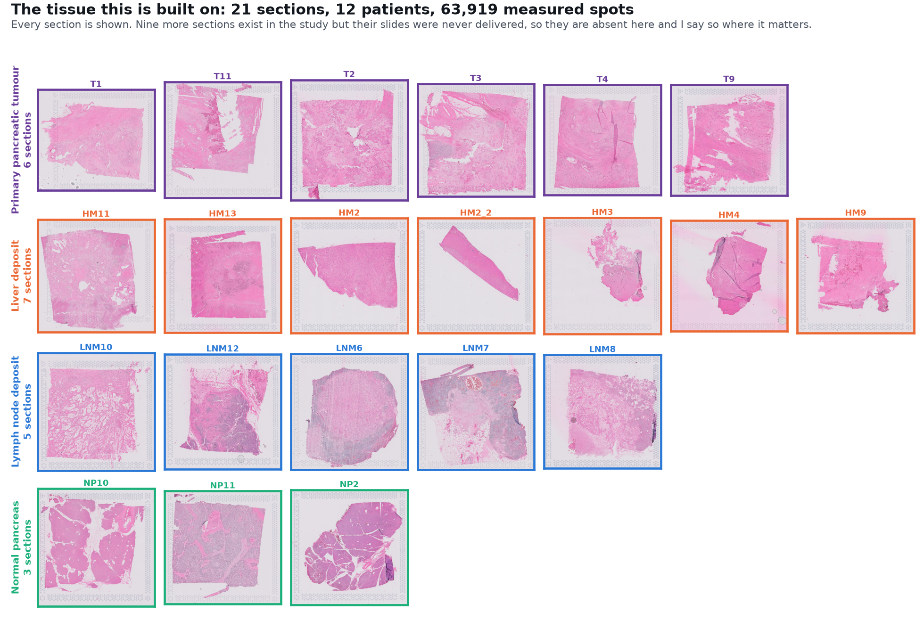
The tissue I am working with
21 sections from 12 patients, every one shown here.
Six primary tumours, seven liver deposits, five lymph node deposits, three normal pancreas. 63,919 measured spots in total.
Notes:
I want to put the data in front of you before any result, because the honest answer to 'how much can you conclude' comes mostly from this slide. Twenty one sections, twelve patients. You can see the tissue variety yourself. I should also say plainly that nine further sections belong to this study but their slides were never delivered to us, and later on I will show you one specific analysis that this makes impossible rather than merely harder.

Slide 3
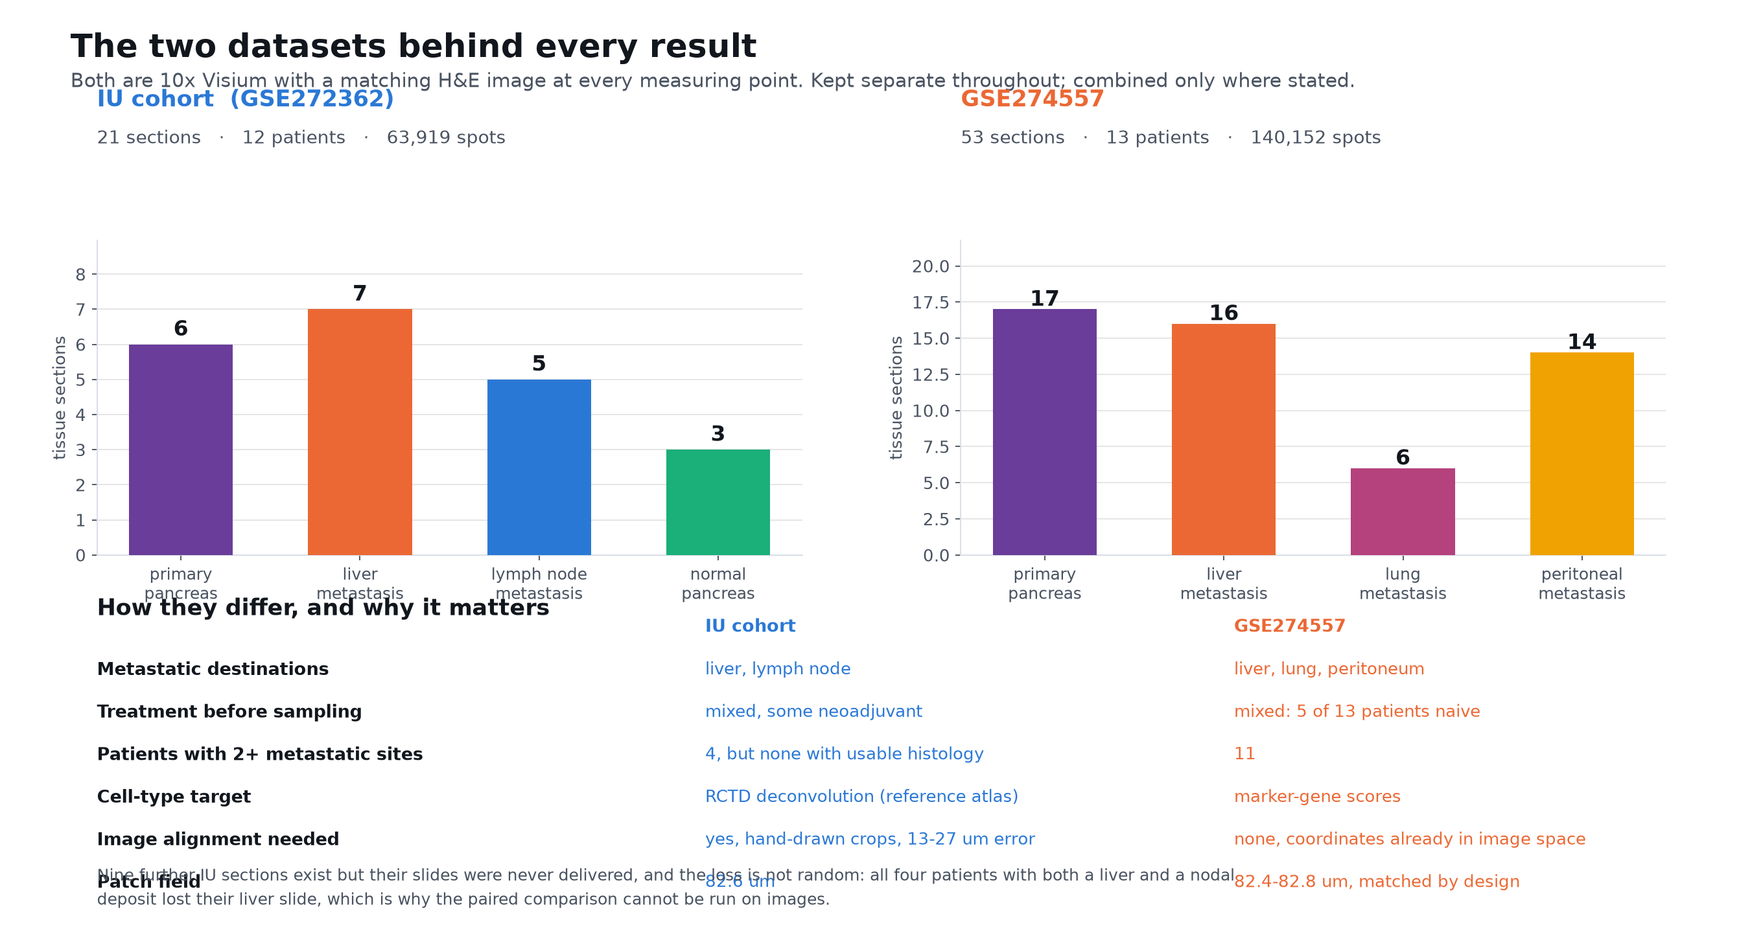
Both datasets, side by side
Everything in this talk comes from these two.
Kept separate throughout. Where they agree, the result is about the tissue rather than about one cohort.
Notes:
HOW TO READ THIS CHART. Two bar charts, one per cohort, and the bars are simply how many tissue sections of each type that cohort contains. Colour marks the tissue: purple primary pancreas, orange liver, blue lymph node, magenta lung, amber peritoneum, green normal pancreas. Underneath is a plain table of the differences that matter.
WHAT IT MEANS. This is the slide to come back to if you want to know what any number rests on. Left is our cohort, right is the published one, and the bars are what tissue each actually contains. I want to flag one thing against myself. Earlier in this project I described the second cohort as treatment naive, and that was wrong: five of its thirteen patients are untreated and the other eight had chemotherapy, so it is a mixed cohort much like ours. I had carried that from an early note without checking the sample sheet. It removes one advantage I had claimed for it, but not the others. It still has three metastatic destinations rather than two, eleven patients with more than one metastatic site rather than four, and it needs no image registration at all because its coordinates already sit in the delivered image's pixel space.

Slide 4
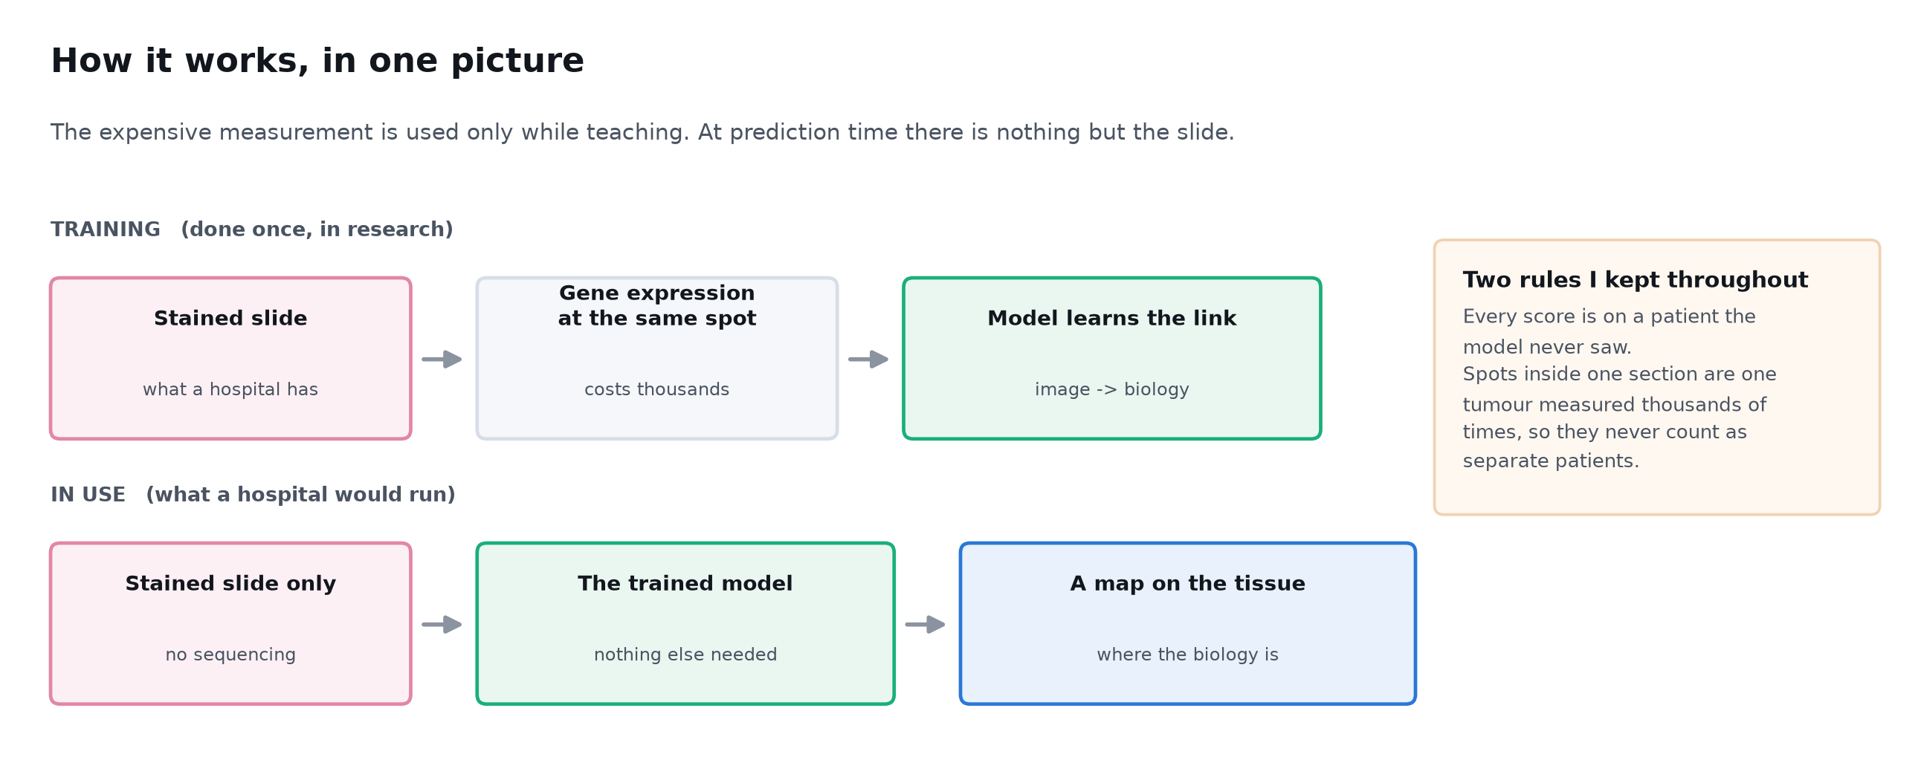
How the method works
Expression teaches the model. At prediction time there is only the slide.
Every number I show you comes from a patient the model has never seen.
Notes:
This is the whole technical approach and I will not go deeper than this unless you want me to. Top row is training, which happens once, in research, where we have both the slide and the sequencing. Bottom row is what a hospital would actually run: a slide goes in, a map comes out, no sequencing anywhere. The box on the right is the part I would push back on if someone showed me this work. Every score is on a held-out patient, and spots inside one section are treated as one tumour rather than thousands of independent samples. Getting that second point wrong is the easiest way to produce a beautiful and completely false result here.

Slide 5
Part one: can a slide see cancer at all?
Before asking anything about spread, establish the floor.
Notes:
I want to start with the easiest possible question, because if the answer to this one were no, nothing after it would be worth discussing.

Slide 6
Q1
QUESTION
Can a stained slide tell cancer from normal tissue?
Why we are asking
What each answer would mean
Everything later depends on this. If the image cannot separate tumour from healthy pancreas, then any later success must be coming from somewhere other than the cancer.
A high score means the image genuinely carries cancer information.
A low score would mean the whole approach is dead and we should stop.
Notes:
This is my floor test. We have three sections of normal pancreas alongside six primary tumours, so we can hold the organ constant and vary only the presence of cancer. Note this is the fair version: same organ, same tissue type.

Slide 7
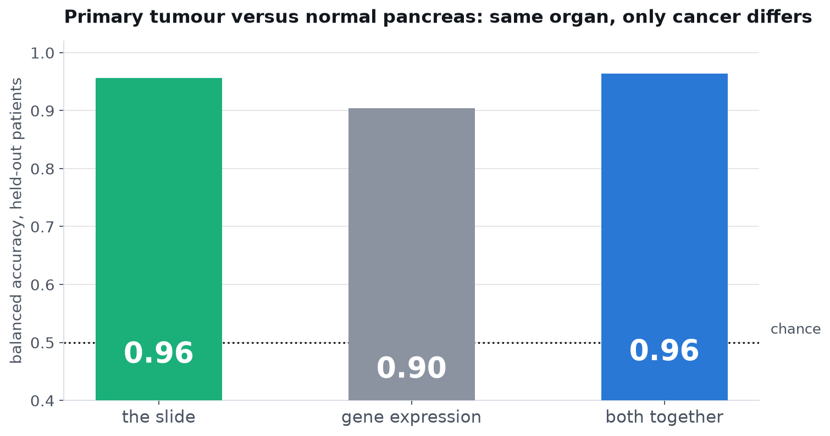
Q1 YES, and clearly
The image separates tumour from normal pancreas at 0.96, slightly ahead of gene expression at 0.90.
Same organ, same tissue type, only cancer differs. Leave-one-patient-out. The image can see cancer.
Notes:
0.96 for the image against 0.90 for expression. So the slide is not blind, and it is actually better than the transcriptome at this particular job. Keep that number in mind, because it makes the later negative result much more interesting: the image can see cancer, it simply cannot see what we want it to see about spread.

Slide 8
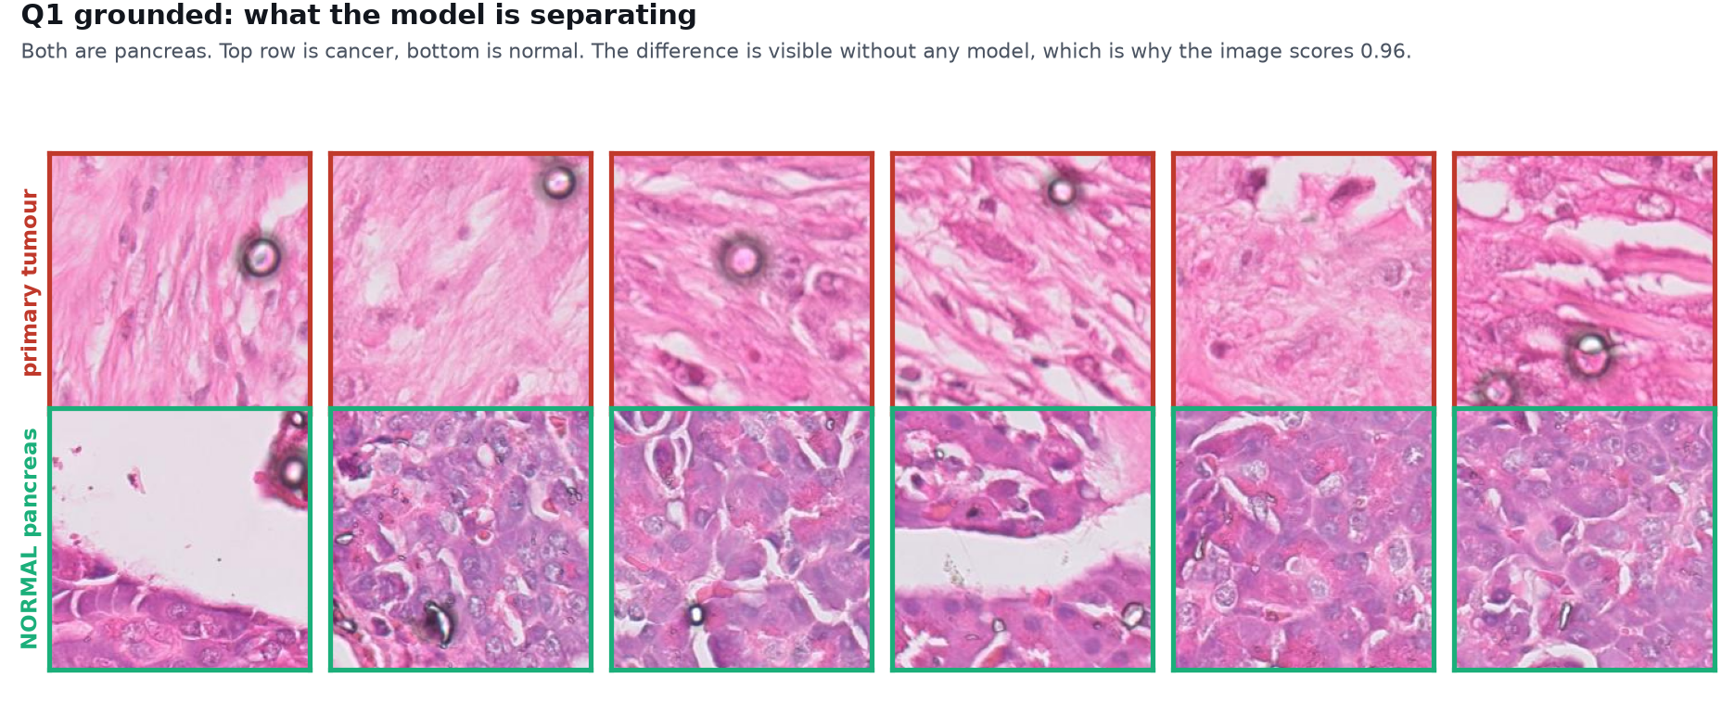
Q1 SHOWN ON THE TISSUE
Both rows are pancreas. Top is cancer, bottom is normal.
No model is needed to see this difference, which is why the score is 0.96.
Notes:
I show this so the 0.96 is not an act of faith. The architecture is simply different.

Slide 9
Part two: can it see spread?
The image can see cancer. Now the question the project was built on.
Notes:
Having established the floor, we move to the real question.

Slide 10
Q2
QUESTION
Can a slide tell a metastasis from a primary tumour?
Why we are asking
What each answer would mean
This is the question the whole project was built to answer. If a routine slide could flag metastatic disease, it would be useful in any hospital that has a microscope.
A high score at BOTH metastatic sites means the image reads metastasis.
A high score at only one site means something else is going on.
Notes:
The design point that matters: we test liver deposits and lymph node deposits SEPARATELY. Anyone can get a good number by pooling them. The split is what makes the result interpretable.

Slide 11
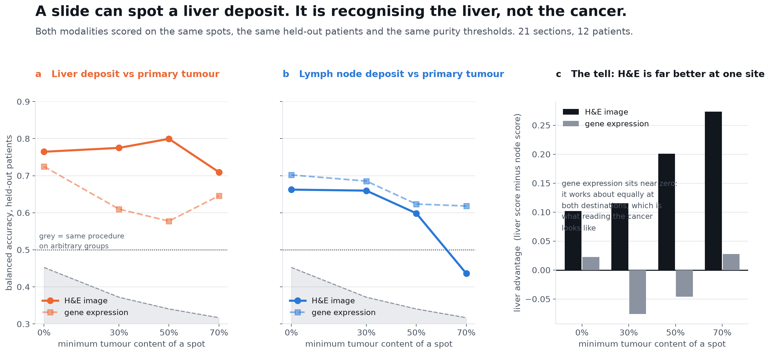
Q2 ONLY IN THE LIVER
Liver deposits separate from primary at 0.80. Lymph node deposits reach only 0.60, and fall to 0.44 once only tumour-rich areas are used.
The same model, the same procedure, two destinations, two very different answers. These numbers are UNI2-h; two other encoders narrow the gap, and Q14 shows by how much.
Notes:
HOW TO READ THIS CHART. Three panels. Left and middle are line charts. The horizontal axis is how much tumour I insist a measuring point contains before I use it, from every point on the left to only the purest on the right. The vertical axis is accuracy, where 0.5 is a coin flip. Solid line is the H and E image, dashed line is gene expression, and the grey band at the bottom is what the identical procedure gives on meaningless groups. Left panel is liver deposits against primary, middle is lymph node against primary. The right panel subtracts one from the other, so it is how much better the image is at liver than at lymph node.
WHAT IT MEANS. I would read the left panel and the middle panel together. Liver holds up as we strip away non-tumour tissue; lymph node collapses. The right panel is the summary: the image's advantage at liver over lymph node grows from 0.10 to 0.28 as tissue is removed, while gene expression stays flat near zero, working equally at both. A signal that only works where the surrounding organ is distinctive is a signal about the organ.

Slide 12
Q3
QUESTION
Is it seeing metastasis, or just seeing liver?
Why we are asking
What each answer would mean
This objection was raised in review and it is the right one. Liver is easy to recognise even with no tumour in it at all, so a good score on liver deposits may mean nothing about cancer.
Train a detector on ONE site, test it on the OTHER.
If it learned metastasis, it transfers. If it learned liver, it cannot, because a lymph node is not a liver.
Notes:
This is the sharpest test available and it needs no extra data. It is the same logic as asking whether a bird detector trained only on sparrows recognises an eagle.

Slide 13
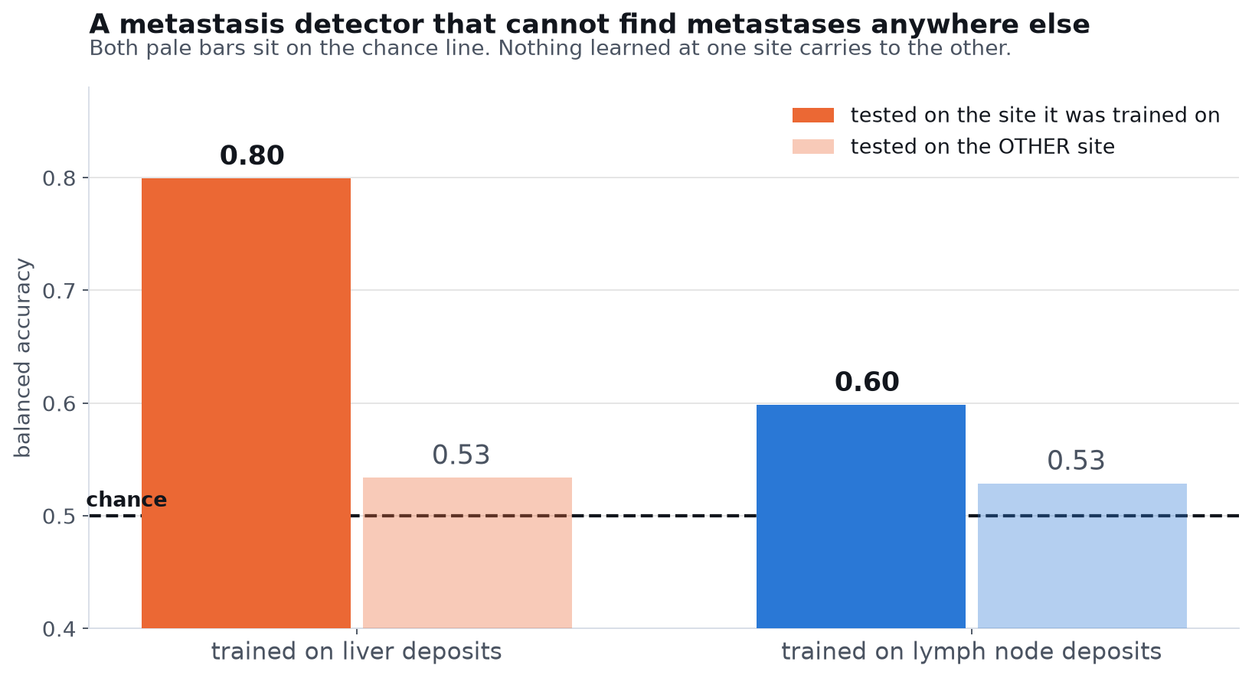
Q3 IT IS SEEING THE LIVER
Trained on liver, tested on lymph node: 0.53. The other direction: 0.53. Chance is 0.50.
Nothing learned about liver deposits transfers to nodal deposits, and Q14 shows this is true of all three encoders I tried.
Notes:
HOW TO READ THIS CHART. Four bars in two pairs. The solid bar in each pair is the model tested on the same metastatic site it was trained on. The pale bar next to it is the SAME model tested on the other site. The dashed line across the middle is chance. So the whole question the picture asks is whether the pale bar stays up near the solid one or drops to the line.
WHAT IT MEANS. This is the most important negative in the whole project and I want to be blunt about it. The 0.80 we just celebrated contains nothing that generalises. The image is combining two things it genuinely can see, this is cancer and this is liver, into something that looks like a metastasis detector and is not one. Expression transfers slightly better but also poorly, which turns out to be a finding in its own right, and it is the next question.

Slide 14
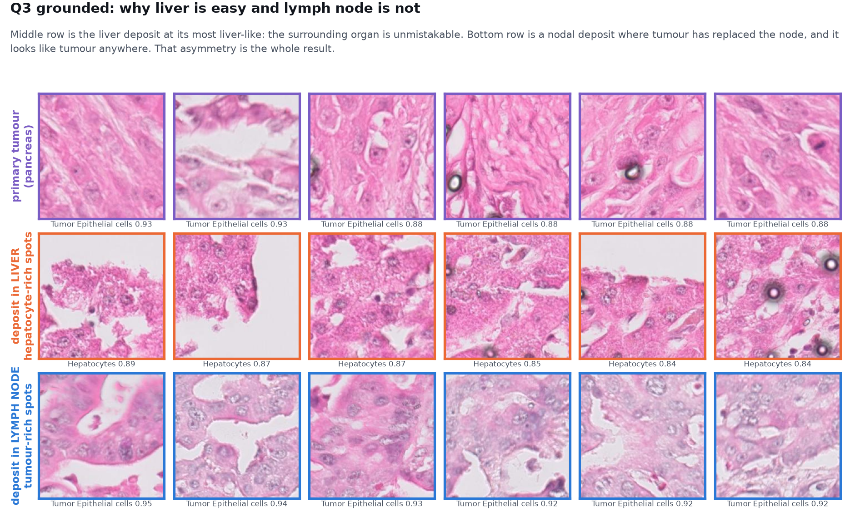
Q3 SHOWN ON THE TISSUE
Why liver is easy and lymph node is not, in real tissue.
The liver row is unmistakable. Primary and nodal tumour look like each other. That is the asymmetry.
Notes:
This is the whole Q3 result in pictures. The middle row shows hepatocyte plates you could not mistake for anything else. The top and bottom rows are both just tumour.

Slide 15
Part three: so why can nothing detect metastasis?
The failure is not about images. It is about what a metastasis is.
Notes:
At this point I stopped trying to fix the model and started asking whether the thing I was trying to detect existed at all.

Slide 16
Q4
QUESTION
Do metastases in different organs share one programme?
Why we are asking
What each answer would mean
If a liver deposit and a nodal deposit from the SAME patient are doing different things, then there is no single thing to detect, and every model above was chasing something that does not exist.
Fully shared would mean one metastatic programme and our models were simply weak.
Partly shared would mean the target itself is site-dependent.
Notes:
Four patients gave us tumour from both a liver and a lymph node deposit, so this comparison happens inside one person and patient differences cancel out entirely.

Slide 17
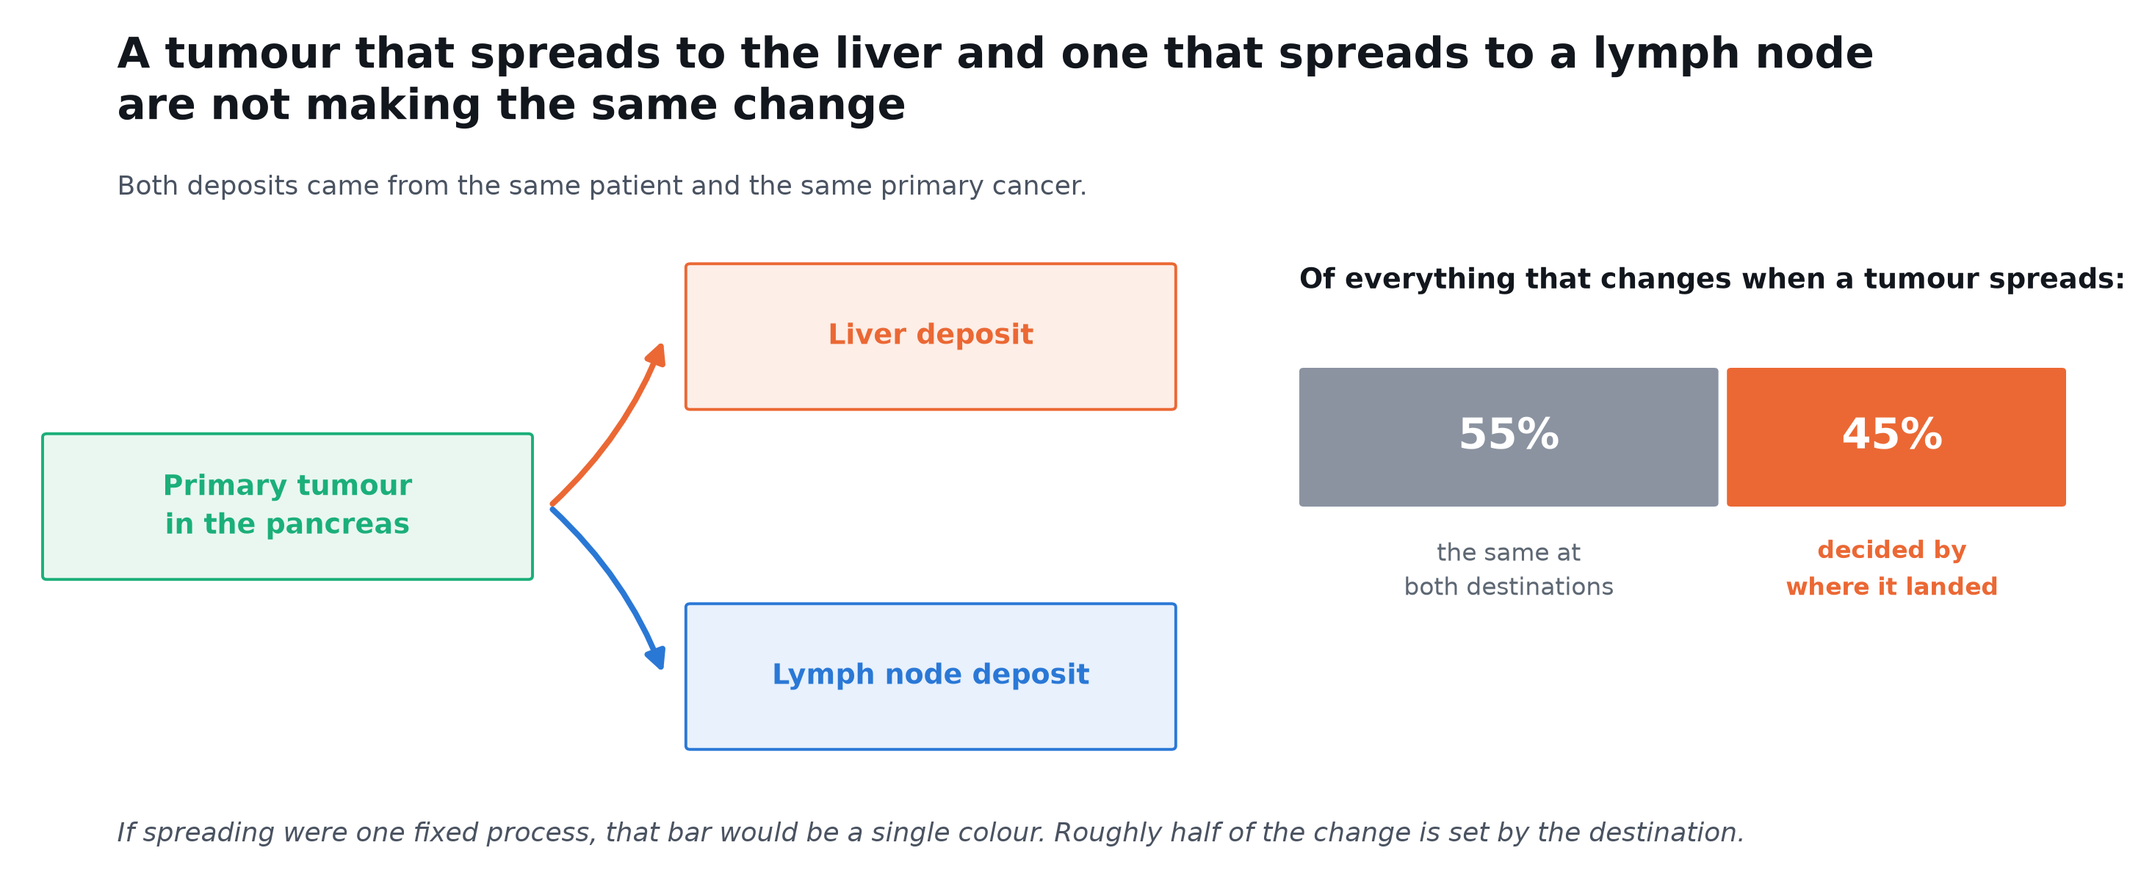
Q4 ONLY ABOUT HALF
Roughly 55 percent of what changes is shared between the two destinations. The rest is decided by where the tumour landed.
Same patient, same cancer, two destinations, and only half the change is common to both.
Notes:
HOW TO READ THIS CHART. The left half is a diagram rather than data: one primary tumour with two arrows to the two places it spread. The right half is a single bar split in two. The whole bar is everything that changes when a tumour becomes a metastasis, across 42 measured features. The grey part is the share that is the same at both destinations, the orange part is the share that depends on where it landed. If metastasis were one fixed process the bar would be entirely grey.
WHAT IT MEANS. This reframes everything before it. I was not failing to detect metastasis; I was trying to detect something that is only half a thing. About half of becoming a metastasis is shared, and the other half depends on the destination.

Slide 18
Q5
QUESTION
What is the part that differs?
Why we are asking
What each answer would mean
If half the programme is site-specific, knowing WHICH half is the clinically useful part. It tells us what the destination is doing to the tumour.
If it is immune, the destination is shaping the immune environment.
If it is tumour-intrinsic, the tumour is adapting itself.
Notes:
We tested 42 features one at a time and corrected for testing 42.

Slide 19
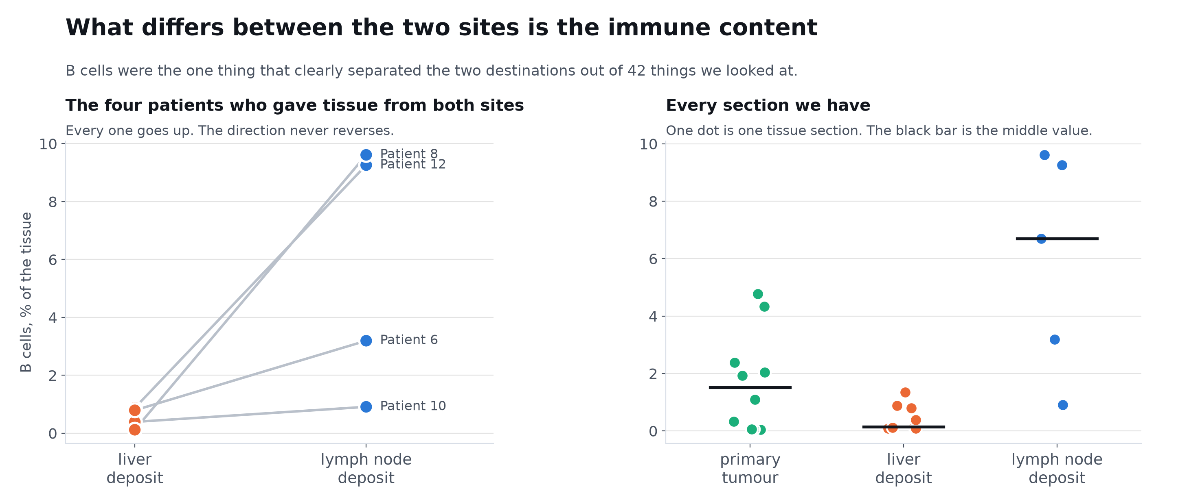
Q5 IT IS IMMUNE
B cell content is the one feature that separates the two sites and survives correction. It rose in all four patients measured at both sites.
Effect size 2.0, and with four paired patients what carries the weight is that the direction never reverses.
Notes:
HOW TO READ THIS CHART. Left panel: each line is ONE patient measured twice, once in their liver deposit and once in their lymph node deposit. The left end of a line is the liver value, the right end the node value, so a line sloping upwards means that patient had more B cells in the node. Right panel: every section we hold, one dot each, grouped by tissue type, with the black bar marking the middle value.
WHAT IT MEANS. The left panel is the one I would look at. Four patients, each measured at both of their own sites, and every single one rises. The obvious objection is that a lymph node is a lymphoid organ, which the next slide addresses directly.

Slide 20
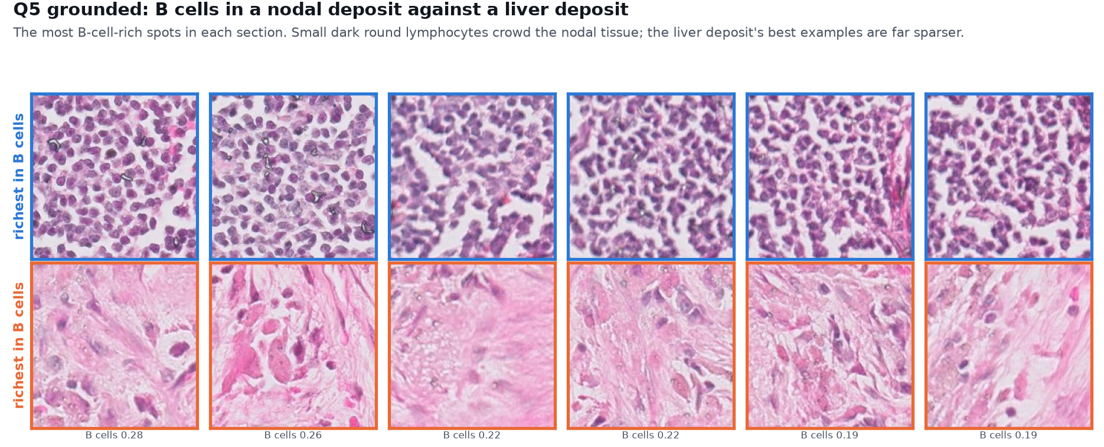
Q5 SHOWN ON THE TISSUE
The most B-cell-rich tissue in a nodal deposit against a liver deposit.
Small dark lymphocytes crowd the nodal tissue. The liver deposit's best examples are far sparser.
Notes:
Same measurement, both sections, ranked by B cell content. The difference is visible.

Slide 21
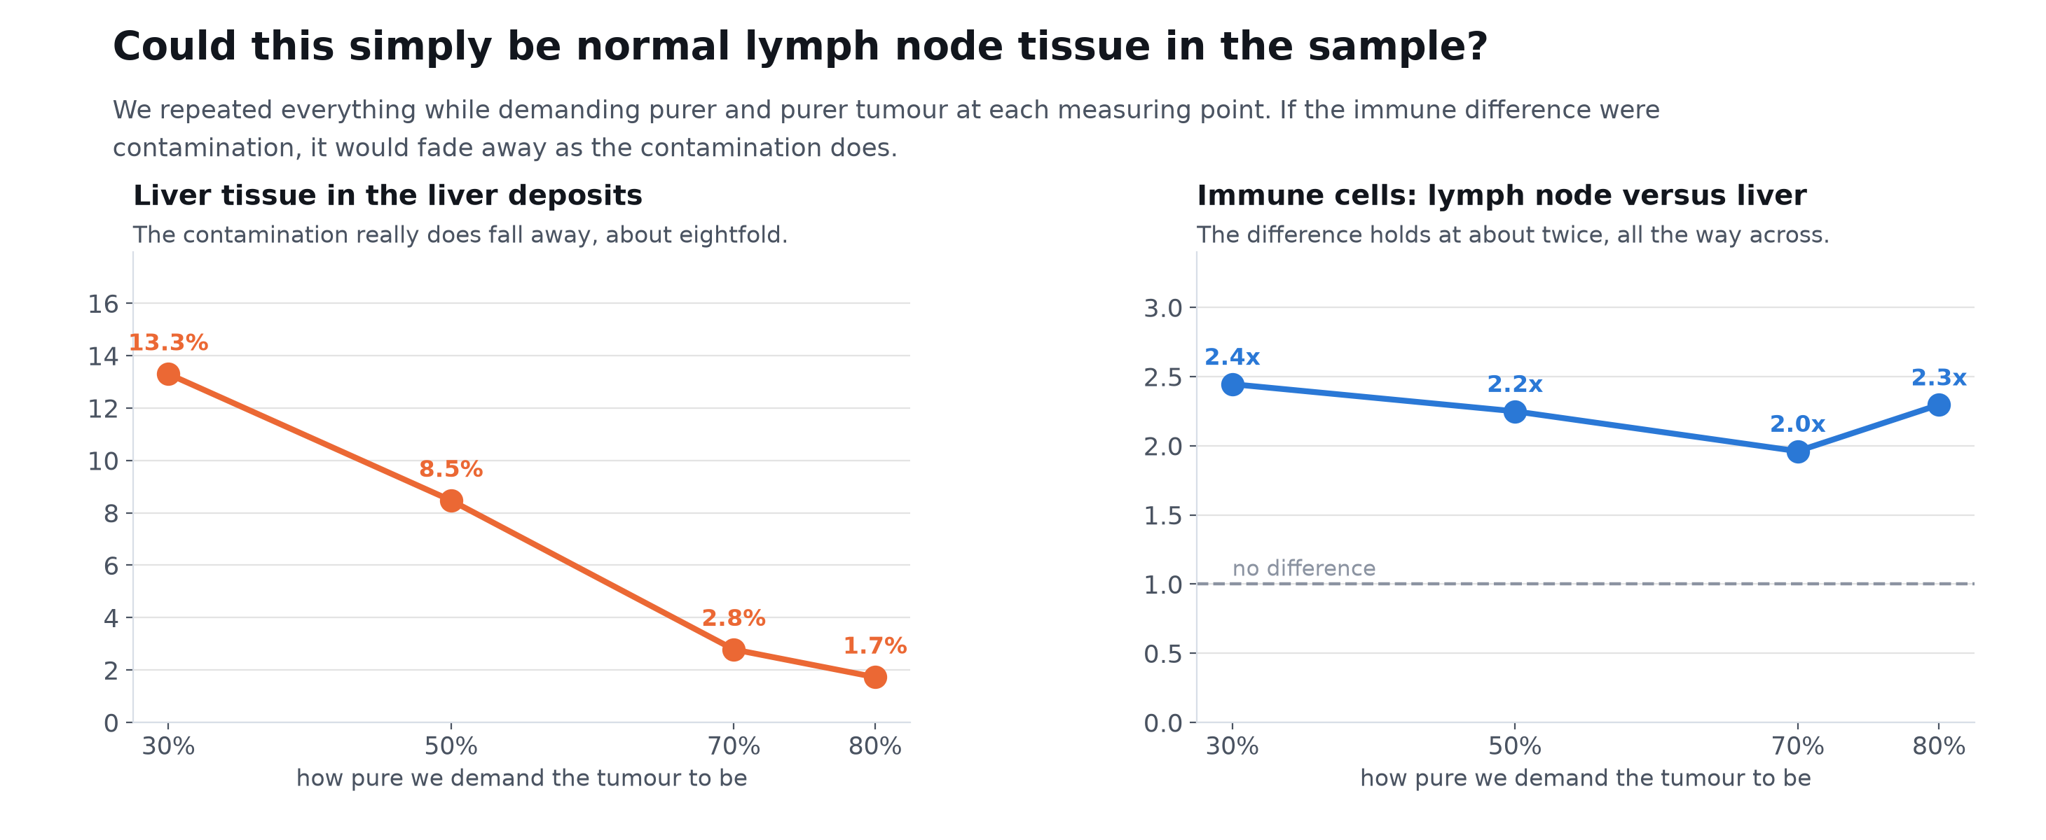
Q5 AND IT IS NOT CONTAMINATION
As we demand purer tumour, liver contamination falls about eightfold while the immune difference holds at roughly twice.
A contamination artefact decays with the contamination. This does not.
Notes:
HOW TO READ THIS CHART. Two line charts sharing a horizontal axis: how pure I insist the tumour is. The left one tracks contamination, the ordinary liver tissue still present in the liver deposits, which should fall as I get stricter. The right one tracks the finding itself, how many times more immune cells the nodal deposits hold than the liver ones, where the dashed line at one would mean no difference at all. The point is that the left line falls steeply while the right line stays flat.
WHAT IT MEANS. This is the control that decides whether the previous slide means anything.

Slide 22
Q6
QUESTION
Does this hold in patients we did not study?
Why we are asking
What each answer would mean
One small cohort is not enough for a claim this structural, particularly when some of our patients had chemotherapy before sampling.
Replication would make it a finding.
Failure to replicate would make it a quirk of thirteen people.
Notes:
We used somebody else's published cohort from another centre. None of those patients had chemotherapy before sampling, and it covers three metastatic sites rather than two.

Slide 23
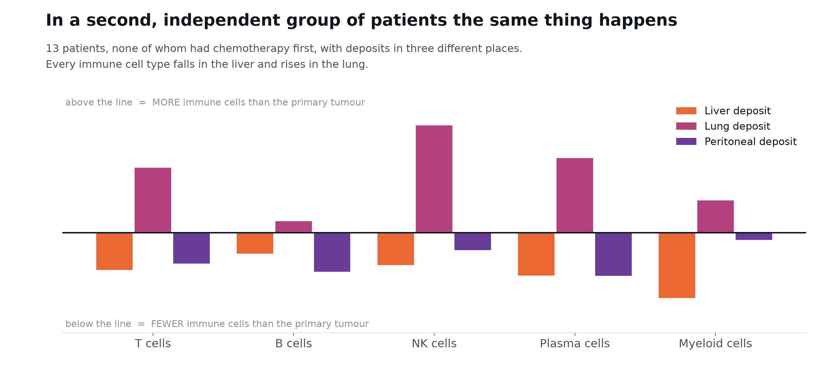
Q6 YES, AND MORE STRONGLY
Liver deposits arrive immune poor and lung deposits immune rich, in a cohort where 5 of 13 patients had no prior chemotherapy.
Every immune cell type falls in the liver and rises in the lung. Not some of them, all of them.
Notes:
HOW TO READ THIS CHART. Grouped bars. Each cluster along the bottom is one immune cell type. Within a cluster there are three bars, one per destination: orange liver, magenta lung, purple peritoneum. The horizontal line through the middle represents the primary tumour, so a bar above the line means more of that cell type than the primary has and below means less. Read the pattern rather than any single bar: orange sits below the line everywhere and magenta above it everywhere.
WHAT IT MEANS. This is the picture I find most striking in the whole talk. The direction matches what is described clinically about liver metastases responding poorly to immunotherapy, and I would value your view on whether that is already established.

Slide 24
Q7
QUESTION
Is this only about pancreas, or about tissue in general?
Why we are asking
What each answer would mean
If tissue context really governs what a slide can say about expression, the effect should appear outside pancreatic cancer entirely.
A prediction made BEFORE looking: an image model should fail to cross organs.
If it crosses fine, our interpretation is wrong.
Notes:
This is a stronger form of argument than the previous ones, because it was derived from them and then tested, rather than observed and explained afterwards.

Slide 25
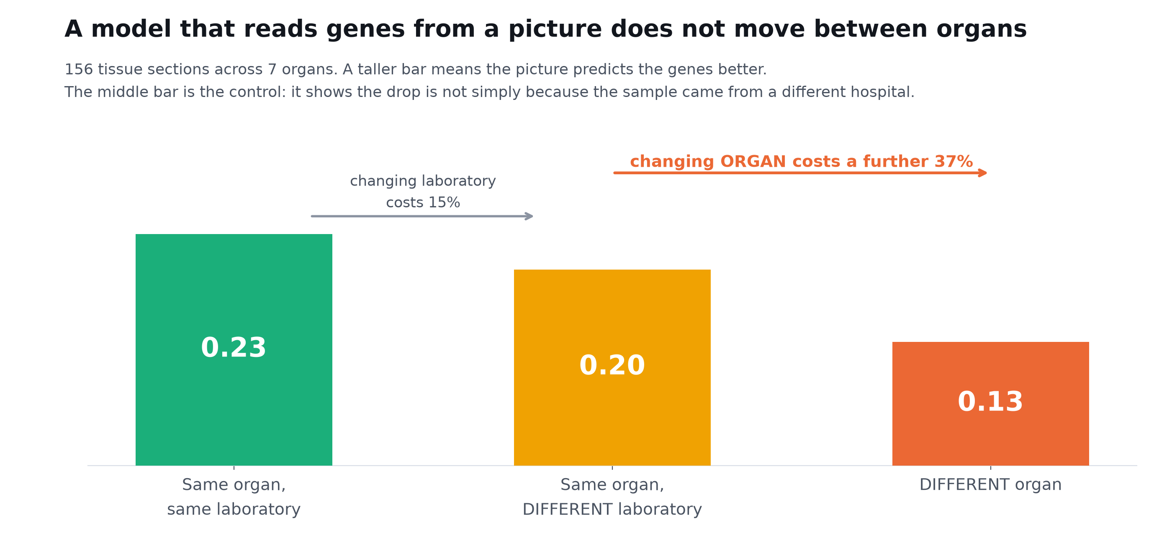
Q7 IT IS GENERAL
Across 156 sections and 7 organs, changing laboratory costs 15 percent. Changing organ costs a further 37 percent.
The middle bar is the control: the loss is tissue biology, not a different hospital or scanner.
Notes:
HOW TO READ THIS CHART. Three bars, left to right, each a harder version of the same task. First: train and test in the same organ and the same laboratory. Second: same organ, different laboratory. Third: a different organ entirely. Taller is better. The two arrows above give the percentage lost at each step. The middle bar is the control, because it changes the laboratory while holding the organ fixed.
WHAT IT MEANS. One thing I should tell you: this analysis first gave me the opposite answer, because three sections labelled whole-transcriptome were actually a targeted panel of about a thousand genes. Filtering them reversed the conclusion. The control decided the result.

Slide 26
Part four: so what IS a slide good for?
It cannot read metastasis. That does not mean it reads nothing.
Notes:
Having been thorough about what fails, let me turn to what works.

Slide 27
Q8
QUESTION
What can a slide read, if not metastasis?
Why we are asking
What each answer would mean
The image clearly carries information. Rather than assume what it sees, we asked it to predict 42 different measured quantities and let the data say.
Anything scoring well AFTER removing tumour amount is genuinely readable.
Anything that only tracks tumour amount is not a new capability.
Notes:
The earlier six-sample work concluded the slide reads tumour abundance and little else. With 21 sections we can test that properly.

Slide 28
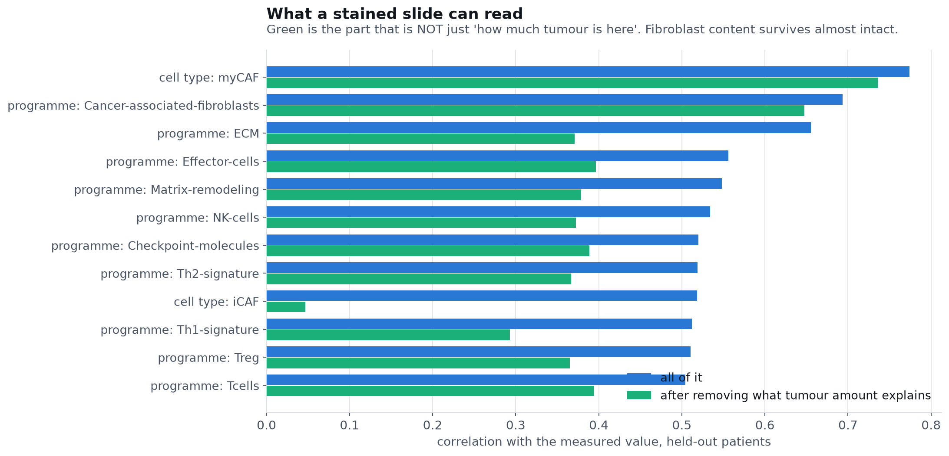
Q8 FIBROBLASTS, VERY WELL
Myofibroblastic CAF content reaches 0.77, and 0.74 even after removing everything explained by how much tumour is present.
This is not the old 'H&E only sees tumour abundance' result. Fibroblast content is read independently, and B cell content partly so.
Notes:
HOW TO READ THIS CHART. A horizontal bar chart with two bars per row. Each row is one thing the image was asked to predict. The blue bar is how well it did. The green bar is what survives after removing everything explainable by simply knowing how much tumour is present. Longer is better, and the green bar is the one that matters, because a target that only tracks tumour amount is not a new capability.
WHAT IT MEANS. myCAF at 0.774 with 0.736 surviving the tumour-content control is the strongest positive result in the project. Clinically this matters because desmoplasia and fibroblast content relate to treatment resistance in pancreatic cancer.

Slide 29
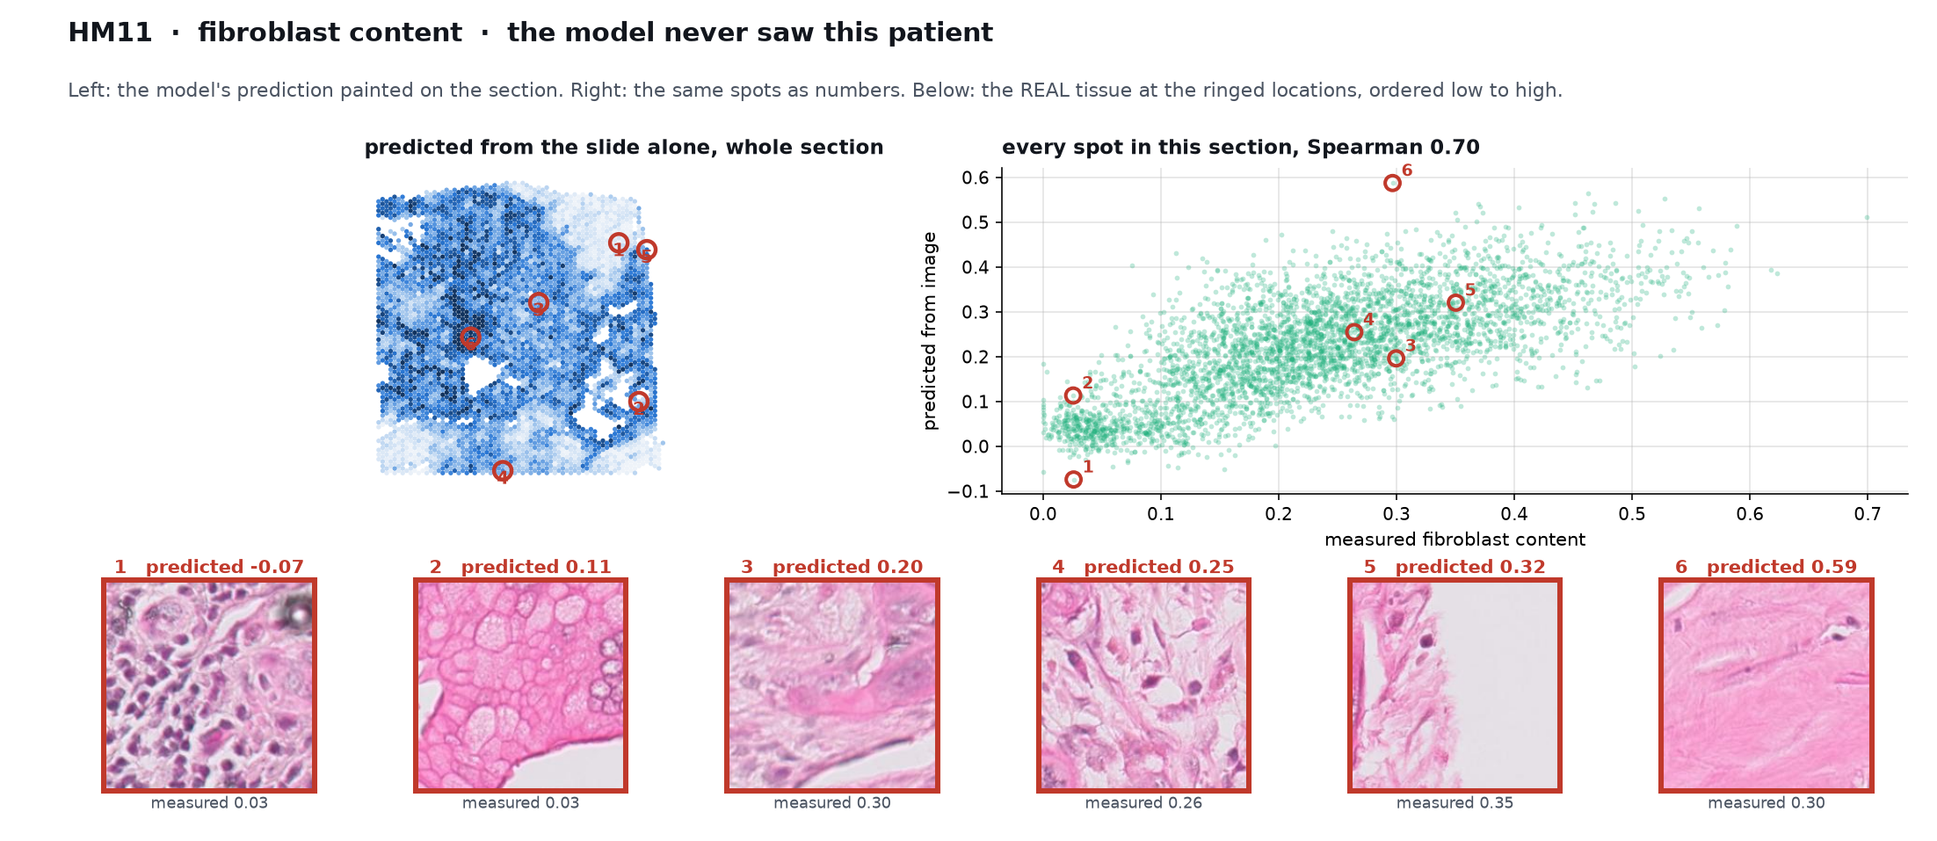
Q8 SHOWN ON THE TISSUE
Fibroblast content predicted from the slide, and the tissue at those exact spots.
Six locations ordered by what the model predicted. The tissue goes from cellular tumour to dense fibrous stroma.
Notes:
The numbered rings on the section are the same six spots shown below it. This is the model's reasoning made checkable.

Slide 30
Q9
QUESTION
Can expression teach the slide, so the hospital only needs the slide?
Why we are asking
What each answer would mean
Spatial transcriptomics costs thousands per section and no hospital runs it. A stained slide costs almost nothing and every hospital has one.
If expression is used ONLY during training, the deployed model needs just an image.
That is the difference between a research tool and a usable one.
Notes:
This is the shape the project was always meant to have, and it is now testable.

Slide 31
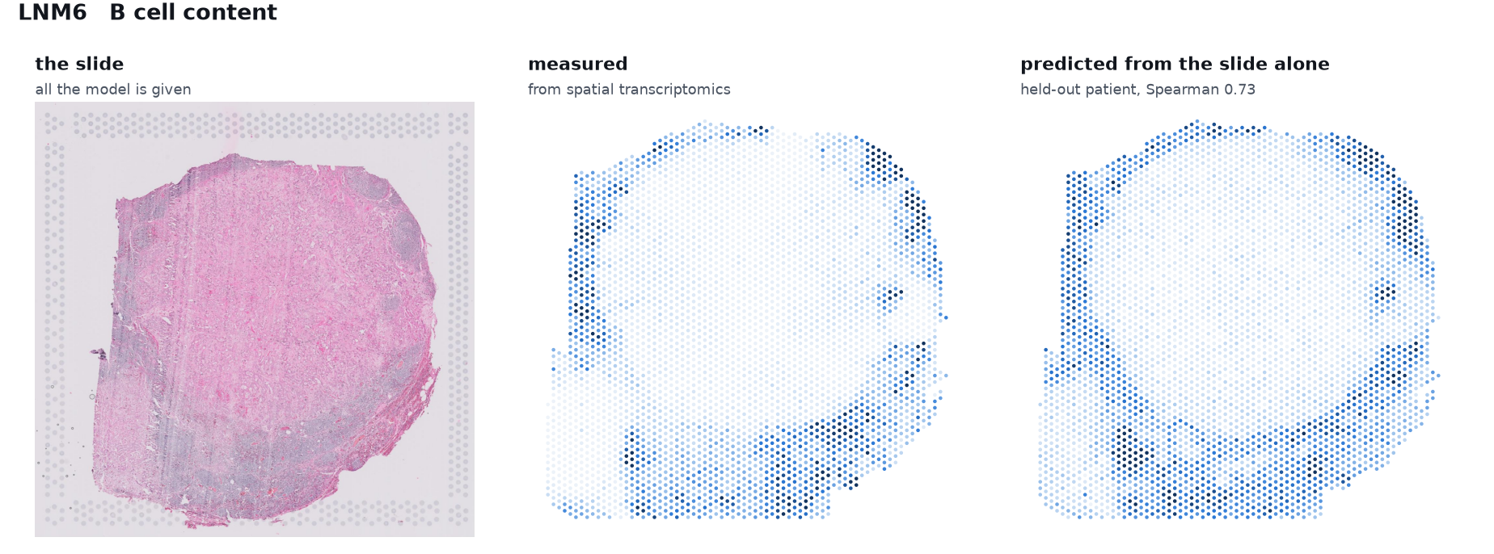
Q9 YES, AND YOU CAN SEE WHERE
Trained with expression, given only the slide at prediction time, and drawn back onto the tissue for a held-out patient.
B cell content predicted from the image alone, Spearman 0.73, placed around the rim of the node, which is where B cell follicles actually sit.
Notes:
HOW TO READ THIS CHART. Left is the section with the model's prediction painted onto every measuring point, darker meaning more. The red rings mark six locations, numbered one to six from lowest prediction to highest. The middle panel plots the same section's spots as predicted against measured, with those six ringed again so they can be found. The row underneath is the real stained tissue at those six locations, in the same order. So the eye can walk from the map, to the number, to the tissue.
WHAT IT MEANS. This is the slide I would most like your opinion on, Dr Masood. The model was never shown this patient. It is given only the stained image and it places the B cells at the rim of the lymph node, which is anatomically where they belong. That is the kind of output a pathologist can check, argue with, and use, rather than a number.

Slide 32
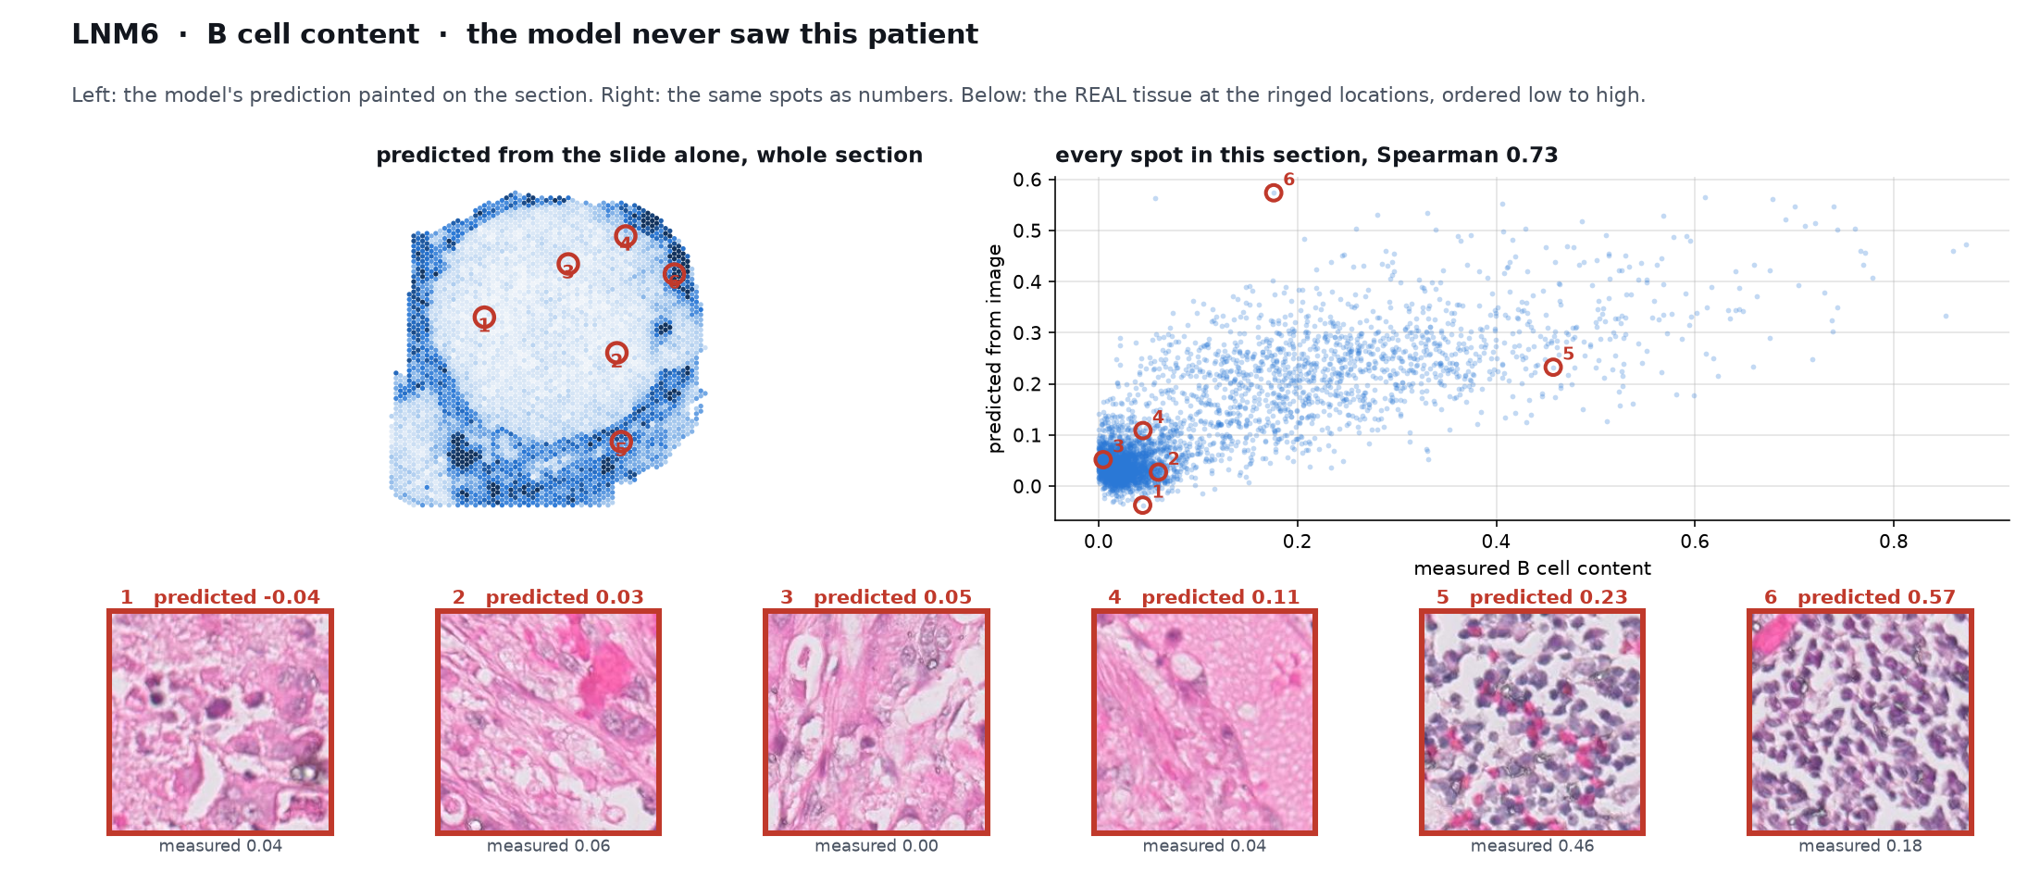
Q9 SHOWN ON THE TISSUE
B cells predicted from the image alone, with the tissue at each location.
Ordered by prediction, the tissue runs from pink stroma to sheets of lymphocytes. The model was never shown this patient.
Notes:
This is the one I would most like a pathologist to argue with. Tile 6 is what the model thought was most B-cell-rich, and it is a sheet of lymphocytes.

Slide 33
Q10
QUESTION
Is it reliable enough to use?
Why we are asking
What each answer would mean
A median score hides everything that matters clinically. A tool that works brilliantly on two thirds of patients and fails on the rest is not yet a tool.
Consistent across sections would mean it is ready to test prospectively.
Wide spread would mean it needs more patients before anyone relies on it.
Notes:
I would rather show you the spread than the average.

Slide 34
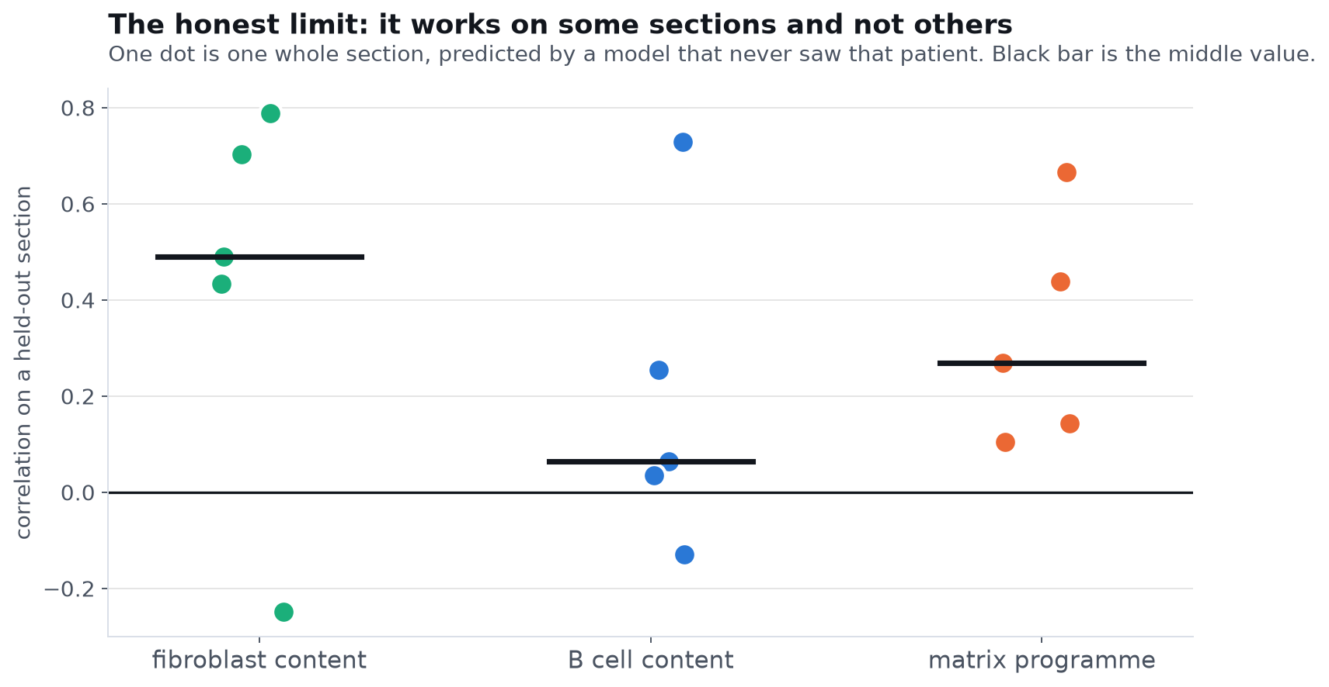
Q10 NOT YET, AND HERE IS WHY
Fibroblast prediction ranges from 0.79 on the best section to below zero on the worst. The median is 0.49.
It works well on some sections and fails on others. With 12 patients we cannot yet predict which.
Notes:
HOW TO READ THIS CHART. A dot plot. Each dot is one whole tissue section, scored by a model that never saw that patient. Vertical position is how well the prediction matched reality in that section, with zero meaning no relationship at all. The black bar is the middle value. The SPREAD of the dots is the point of this chart, not the bar.
WHAT IT MEANS. This is the honest limit, and I would rather show it than a median. The biology is real and replicated, and the fibroblast read-out is genuinely strong on average, but per section the spread is wide. That is what 12 patients buys you. More patients is the single thing that would change it.

Slide 35
Q11
QUESTION
Could a hospital reach this finding without sequencing?
Why we are asking
What each answer would mean
Everything so far needed spatial transcriptomics at thousands of pounds a section. If the same conclusion can be rebuilt from what a slide predicts, it becomes something a hospital could actually run.
Success would turn an expensive research result into a usable test.
Failure tells us which part specifically is out of reach.
Notes:
We rebuilt the entire site-specificity analysis using PREDICTED values in place of measured ones, with two controls against the obvious circularity.

Slide 36
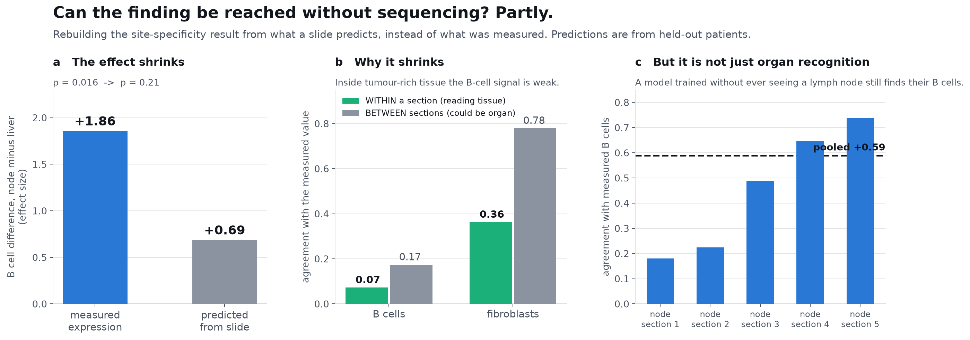
Q11 PARTLY, AND WE KNOW WHICH PART FAILS
The B cell difference survives in direction but loses significance: effect size falls from 1.86 to 0.69.
Panel c is the good news: a model that never saw a lymph node still finds their B cells. So this is not merely organ recognition.
Notes:
Three things here. The effect shrinks and stops being significant. Panel b says why: inside tumour-rich tissue the B cell signal is weak, and most of what the slide reads is between whole sections. Panel c is the control that saves it from being circular: a model trained without a single lymph node still predicts B cell content in nodal sections at 0.59, so it is reading tissue and not just naming the organ. There is also a hard structural limit here worth stating plainly: all four patients who had BOTH a liver and a nodal deposit lost their liver slide among the nine that were never delivered, so the paired test that carried the original result cannot be run on images at all.

Slide 37
Q12
QUESTION
Does the fibroblast read-out hold in other people's data?
Why we are asking
What each answer would mean
This is the strongest positive result in the project and it rests on twelve patients from one centre, which is exactly the situation where a result looks solid and is not.
Train on our sections only, then apply it unchanged to other laboratories.
Nothing refitted, and the target is even defined differently there.
Notes:
This is the test I would want run on my own result before believing it. HEST-1k gives us 158 whole-transcriptome sections from many centres, including four of pancreas for the like-for-like comparison and, usefully, brain as a natural negative control.

Slide 38
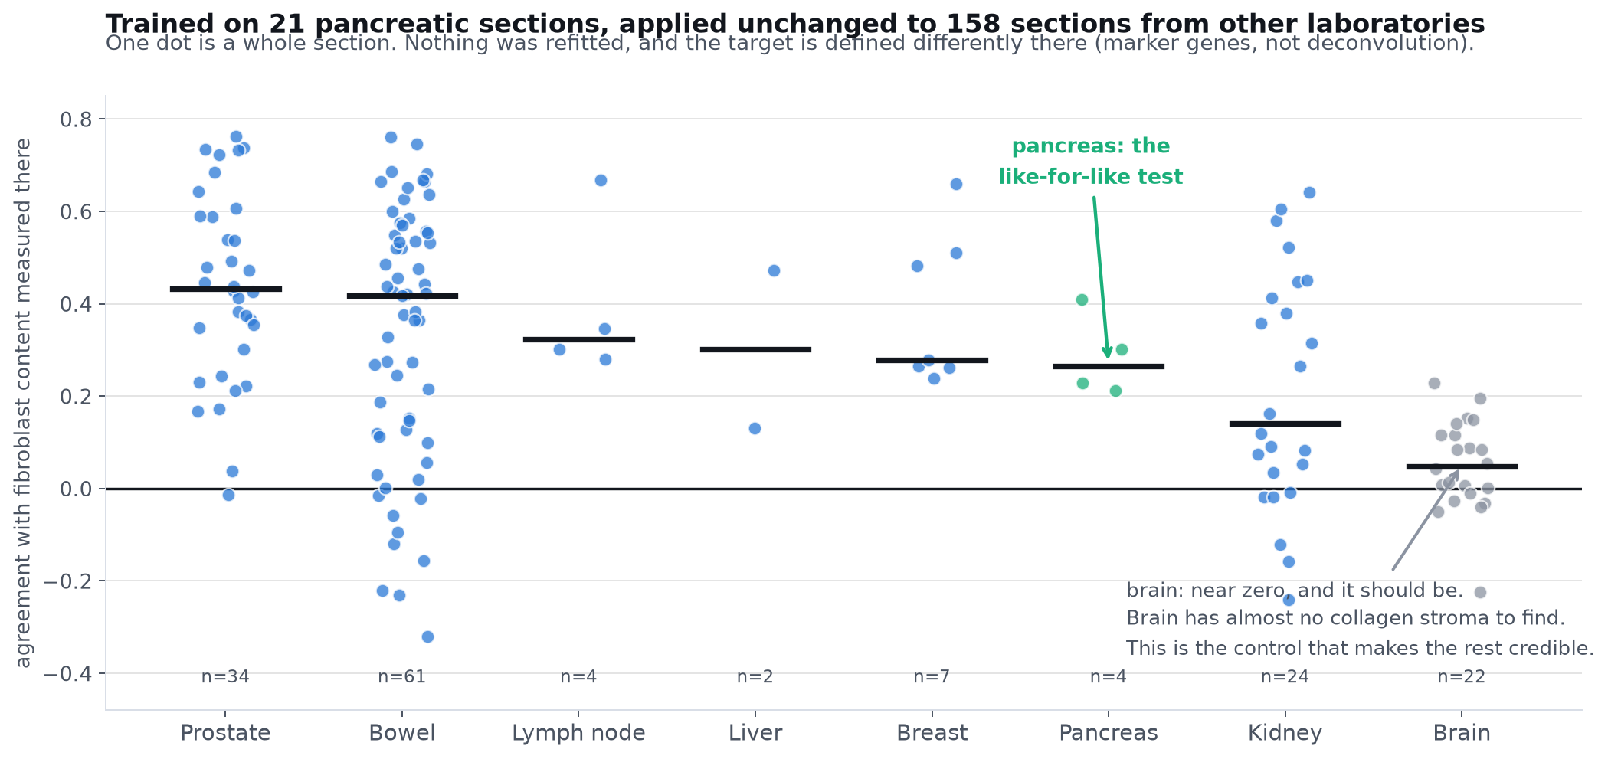
Q12 YES, AND IT FAILS WHERE IT SHOULD
Applied to 158 sections from other laboratories: median agreement 0.30, and 0.27 on the four pancreas sections specifically.
Brain sits at zero, which is the control that makes the rest credible: brain has almost no collagen stroma to find.
Notes:
Two things make this convincing rather than merely positive. First, nothing was refitted and the target there is a marker-gene score rather than a deconvolution, so agreement across two different definitions is a harder test than agreement across one. Second, brain comes out at 0.05. A model that scored well everywhere would worry me; a model that finds no fibroblasts in the one tissue that has almost none is behaving.

Slide 39
Q13
QUESTION
Is it usable, and do we know what it is looking at?
Why we are asking
What each answer would mean
A spot-level correlation is not something a clinician can act on, and a foundation model nobody can interrogate is hard to trust in a hospital.
Averaging over a section gives the shape a report would take.
Regressing the output on named image statistics says what it keys on.
Notes:
Two practical questions rather than scientific ones, but they decide whether any of this could leave a research setting.

Slide 40
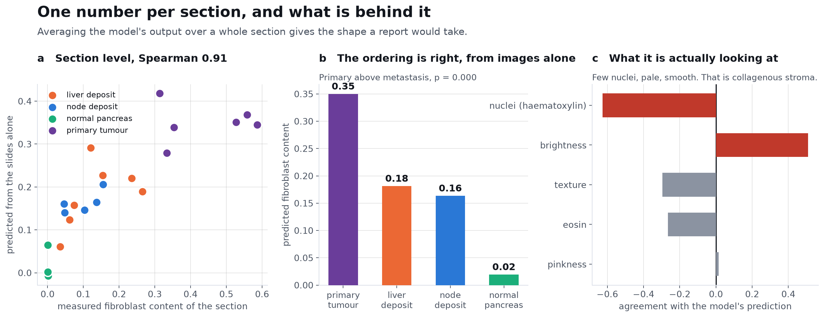
Q13 YES ON BOTH
One number per section tracks measured fibroblast content at 0.91, and the model keys on pale, smooth, nucleus-poor tissue, which is collagenous stroma.
Primary tumours score highest, metastases lower, normal pancreas near zero. That ordering was recovered from the images alone.
Notes:
Panel b is the one I would put in front of a pathologist. From slides alone, the model ranks primary tumour above both metastatic sites and puts normal pancreas at zero. That matches what is known: pancreatic primaries are densely desmoplastic and deposits shed much of that stroma, which is also what our own sequencing showed. Panel c says it keys on tissue that is pale, smooth and short of nuclei. One caution: brightness carries some of the signal, and brightness can drift with staining batch, so any prospective use needs stain normalisation.

Slide 41
Q14
QUESTION
Does any of this depend on which AI model I used?
Why we are asking
What each answer would mean
Every image result so far came from one encoder. If the findings are properties of that encoder rather than of the tissue, none of them mean what I have been saying they mean.
I re-ran everything under three encoders: UNI2-h, H-optimus-1 and Virchow2.
Same spots, same held-out patients, same code. Only the features change.
Notes:
This is the check I would want run on my own work before believing it, and it is cheap once the patches exist. It also caught me overstating one thing, which I will show you.

Slide 42
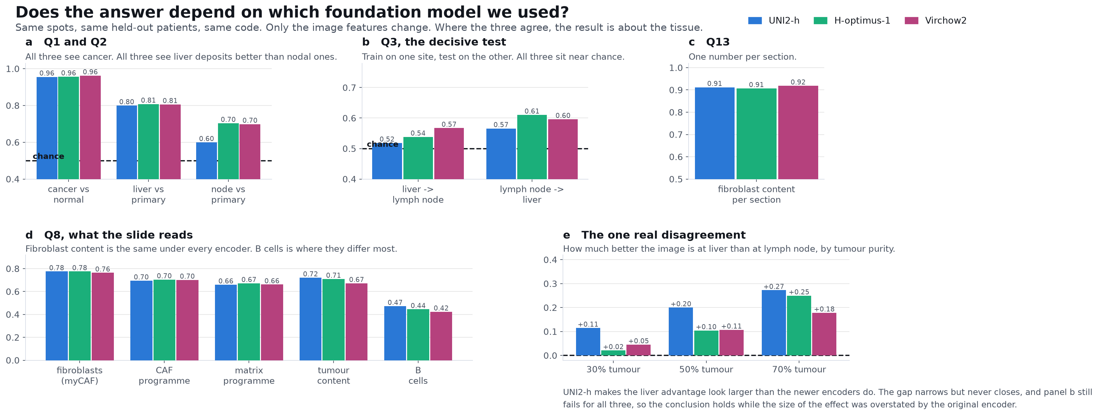
Q14 MOSTLY NO, AND IT CAUGHT ME OVERSTATING ONE THING
The fibroblast result is identical under all three (0.775, 0.775, 0.764). The liver advantage in Q2 is real under all three but about half as large as I showed you.
Panel b is what matters: cross-site transfer stays near chance under every encoder, so the central negative holds.
Notes:
HOW TO READ THIS CHART. Five small panels, and in every one the three coloured bars are the three AI encoders: blue UNI2-h, green H-optimus-1, magenta Virchow2. So within any cluster, three bars of similar height mean the three models agree and the result does not depend on which we picked. Panels a to d are results. Panel e is a difference rather than a result: how much better the image is at liver than at lymph node, so there a smaller bar is better and the disagreement between the encoders is itself the story.
WHAT IT MEANS. I want to be straight about panel e. The newer encoders read lymph node deposits better than UNI2-h does, 0.60 up to 0.70, so the gap between the two sites halves. My Q2 slide showed the widest version of that gap. The conclusion does not change, because panel b is the test that decides it and all three fail it equally. But had I only run the first encoder I would have told you a stronger story than the data supports, and that is worth saying out loud. The fibroblast result, by contrast, is the same to within one hundredth under three different architectures, which is about as reassuring as this kind of check gets.

Slide 43
Q15
QUESTION
Does any of this hold in a completely different cohort?
Why we are asking
What each answer would mean
Everything so far rests on one set of patients from one centre. A second cohort with its own patients, its own scanner and its own laboratory is the only way to know which findings were ours and which were the tissue's.
GSE274557: 52 sections, 13 patients, three metastatic destinations instead of two.
Nothing refitted. The targets are even defined differently there.
Notes:
This is the test that decides whether I have been describing tissue or describing our own cohort. It is also a harder test than it looks, because that cohort has no deconvolution, so the target had to be built differently. Agreement across two different definitions means more than agreement across one shared one.

Slide 44
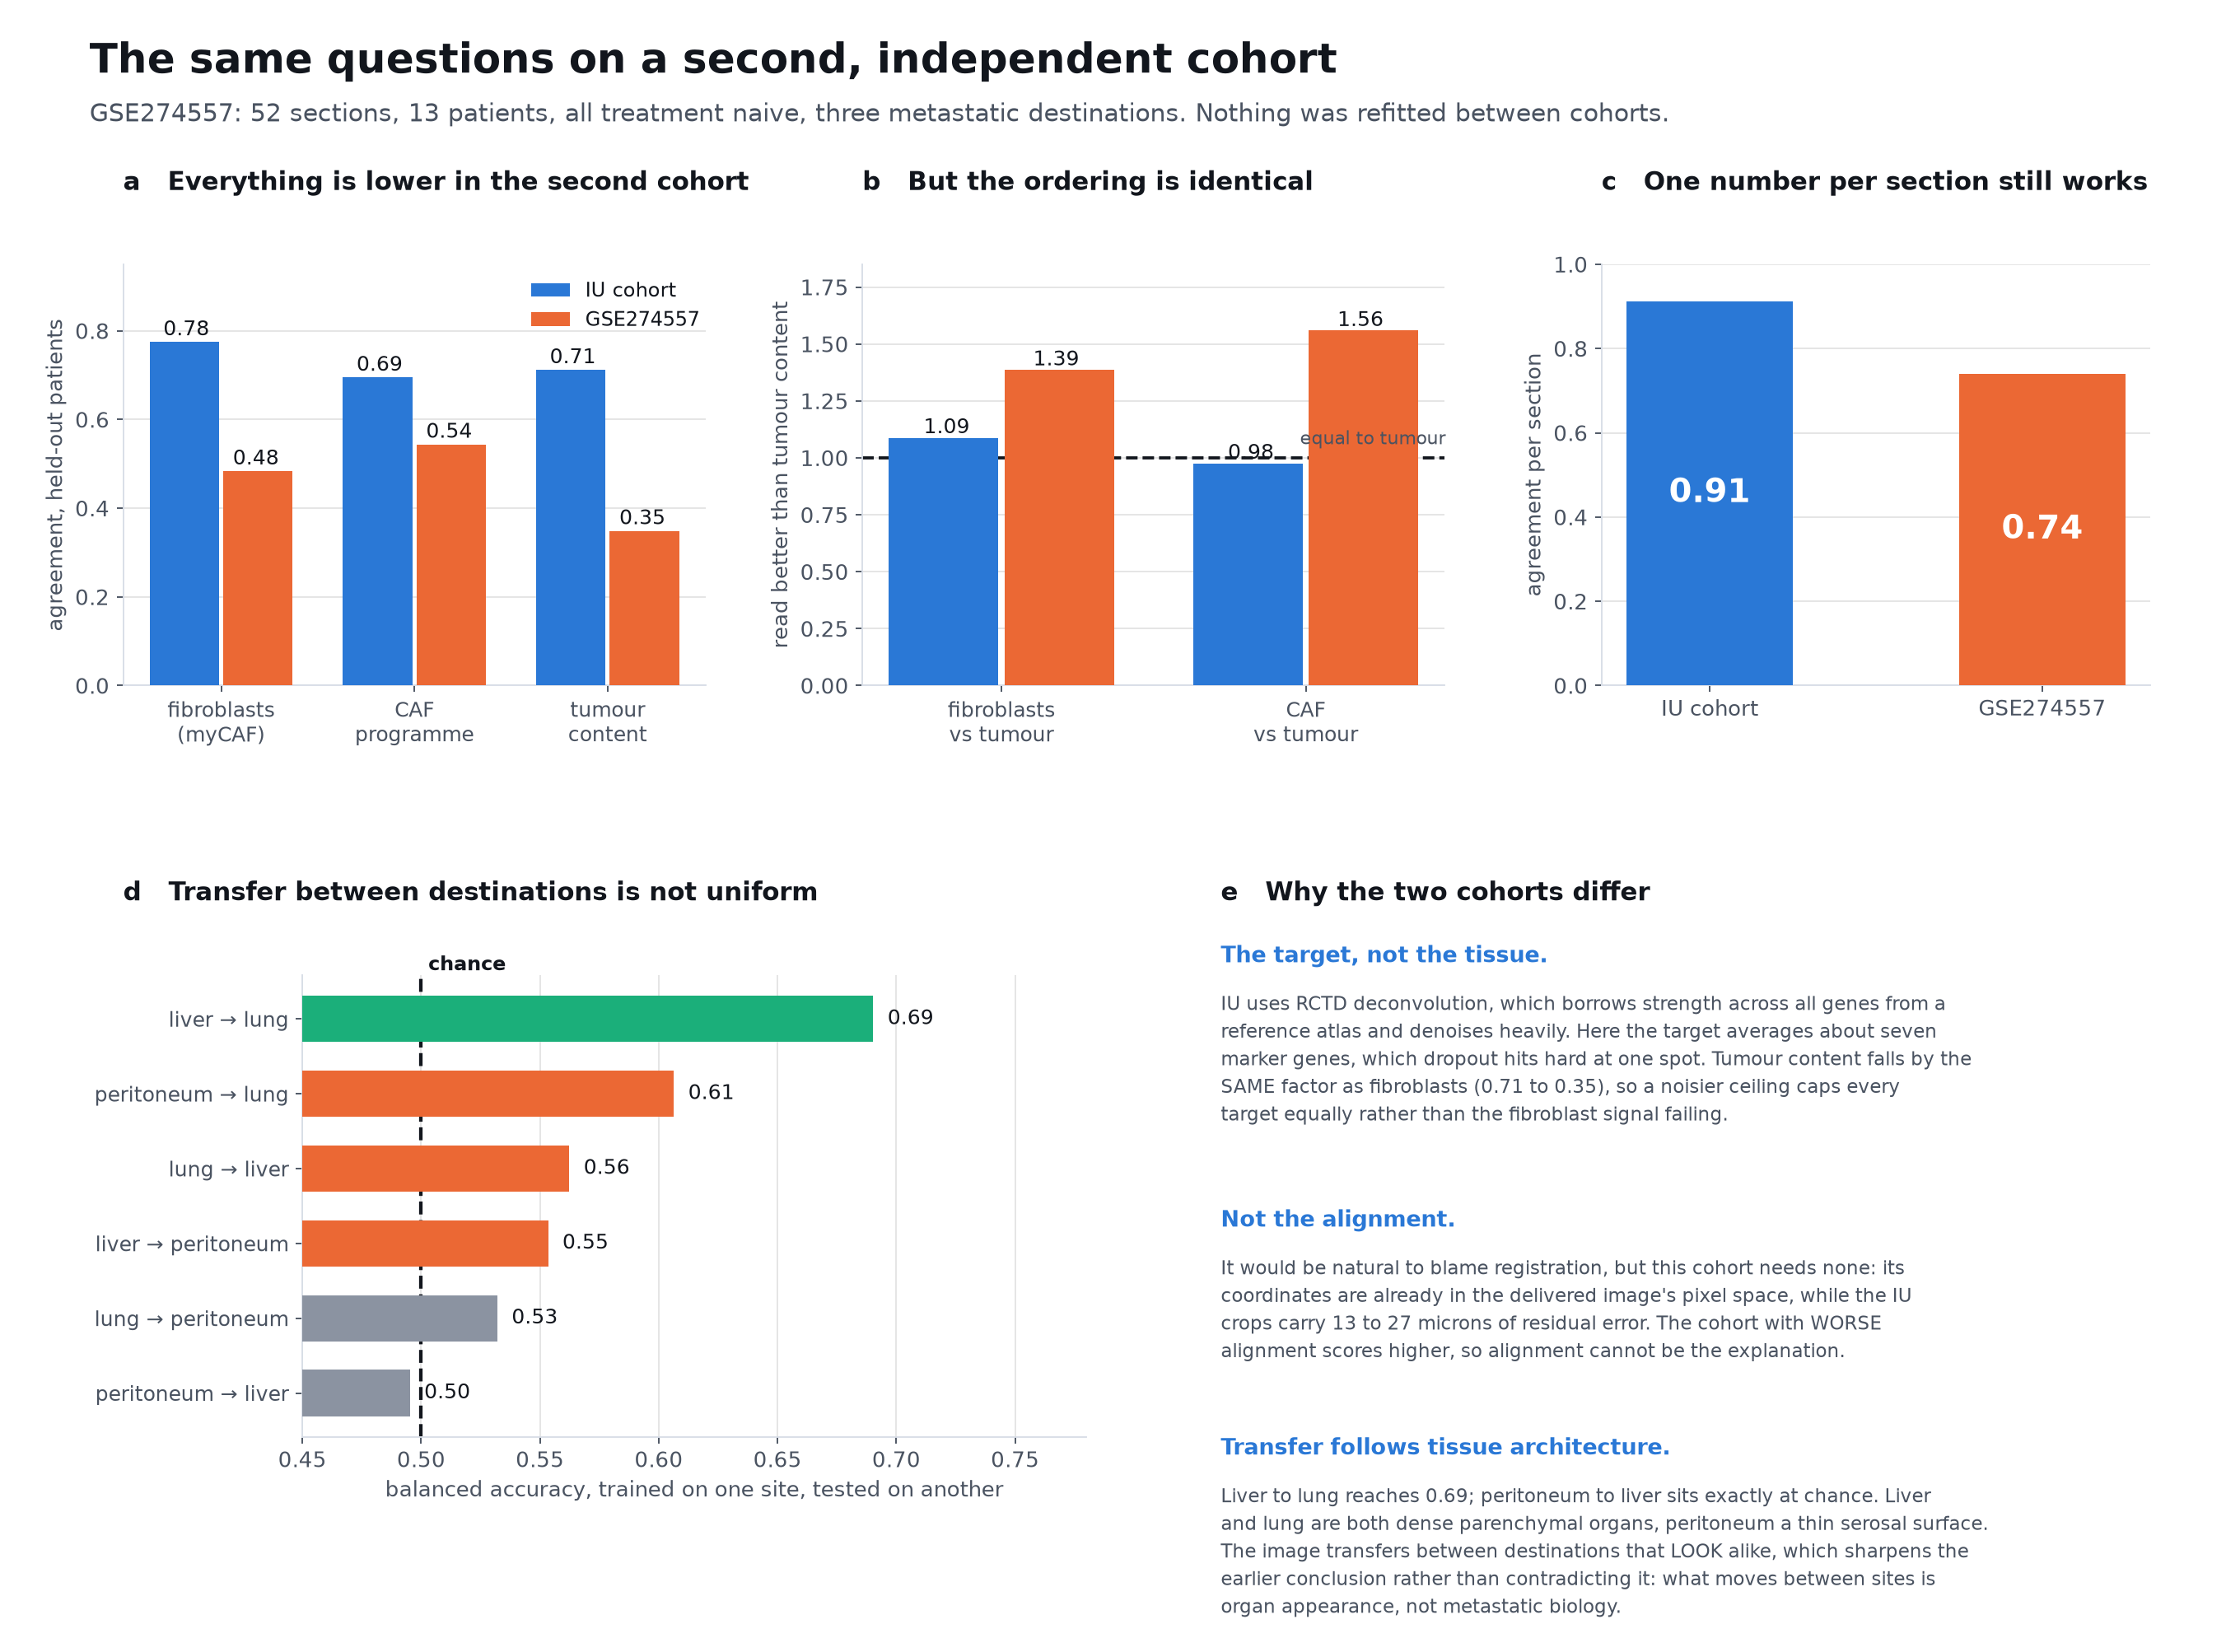
Q15 THE FIBROBLAST READ-OUT HOLDS. THE NUMBERS ARE LOWER AND I CAN SAY WHY
Fibroblast content 0.48 against 0.78, but it is still read BETTER than tumour content in both cohorts, and one number per section still reaches 0.74.
Panel b is the one that matters: the ordering is identical even though every absolute value drops.
Notes:
HOW TO READ THIS CHART. Panel a: paired bars, blue our cohort and orange the second, for three things the image was asked to read. Panel b: the same numbers as a ratio, each target divided by tumour content, so the dashed line at one means no better than simply reading tumour amount. Panel c: one bar per cohort for the section-level score. Panel d: horizontal bars, one per direction of transfer between two metastatic sites, with the dashed line at chance. Panel e is written text, not a chart.
WHAT IT MEANS. Let me deal with the obvious objection first, which is that everything went down. It did, and panel a shows it honestly. But look at tumour content: it falls by the same factor, 0.71 to 0.35. If the fibroblast signal had genuinely failed, it would have dropped while tumour content held. Both falling together means something is capping every target equally, and that something is the target definition. Our cohort has RCTD deconvolution, which borrows information across all genes from a reference atlas and denoises heavily; this cohort has no deconvolution, so I built the target from about seven marker genes, and at a single spot dropout hits that hard. Panel b removes the ceiling by taking a ratio, and there the two cohorts agree closely. I should also say what it is NOT: it is not alignment. This cohort needs no registration at all, its coordinates arrive in the image's own pixel space, while ours carry 13 to 27 microns of residual error. The cohort with worse alignment scores higher, so alignment cannot be the explanation. Panel d is the new finding. With three destinations we can ask which pairs transfer, and it is not uniform: liver to lung reaches 0.69 while peritoneum to liver sits exactly at chance. Liver and lung are both dense parenchymal organs and peritoneum is a thin serosal surface, so the image transfers between destinations that look alike. That sharpens Q3 rather than contradicting it. What moves between sites is organ appearance, not metastatic biology.

Slide 45
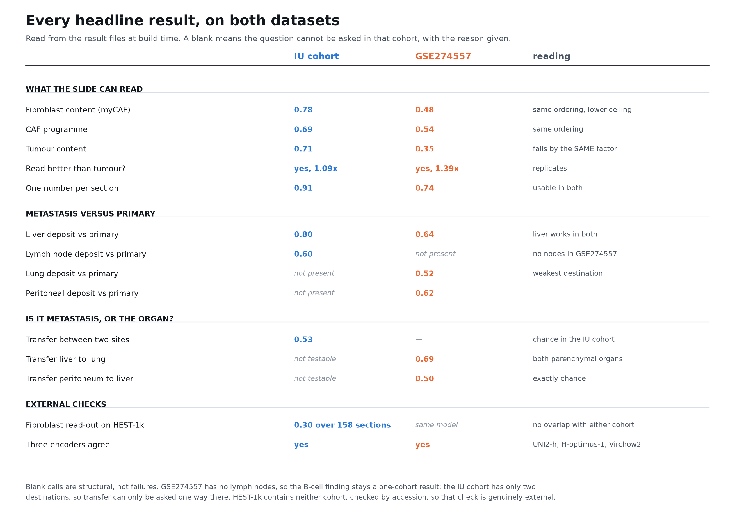
Everything, on both datasets
One table, so nothing has to be taken on trust.
Blank cells are structural rather than failures, and each says why.
Notes:
HOW TO READ THIS CHART. A table, not a chart. One row per result, our cohort in the blue column and the second cohort in the orange one. Grey italic entries are not failures, they mark questions that cannot be asked in that cohort at all, and the right-hand column says why in each case.
WHAT IT MEANS. This is the summary slide. Two things I would draw your attention to. The fibroblast numbers are lower in the second cohort but tumour content falls by the same factor, so what changed is the target and not the biology; the row 'read better than tumour' is the one that shows the finding replicating. And the blank cells are not failures: that cohort has no lymph nodes and ours has only two destinations, so some questions simply cannot be asked in one or the other. I checked by accession that HEST-1k contains neither cohort, so the external check at the bottom is genuinely external.

Slide 46
What I could not do, and what I would do next
The limits are mostly about how much tissue we have, not about method.
Notes:
I would rather walk you through the weak points myself than have them found later.

Slide 47
What I could not do
Nine sections were never delivered, and it cost us a specific test
All four patients who gave BOTH a liver and a lymph node deposit lost their liver slide among those nine. The paired comparison that carried the B cell result cannot be run on images at all. That is not underpowered, it is impossible with what we hold.
Twelve patients is twelve patients
Per section the fibroblast read-out ranges from 0.79 down to below zero. It works well on most sections and fails on some, and with this many patients I cannot yet tell you which in advance.
Nothing here is linked to how patients did
We have no survival or treatment response for these cases, so I can make no claim that any of this predicts outcome. Everything I have shown is about tissue biology.
A 55 micron spot is not a single cell
Each measurement holds up to ten cells. I controlled for this by repeating everything at rising tumour purity, but I cannot separate a tumour cell from the cell touching it.
None of these change the findings. They mark where the findings stop.
Notes:
I want to be the one who says these rather than have them asked. The first is the one that actually annoys me, because it is not a limitation of the method, it is four missing slides that happen to be exactly the four we needed. If those turn up, the paired test becomes possible again. The third is the one that limits what anyone can do with this clinically: with no outcome data I can tell you what the tissue is doing but not whether it matters to the patient.

Slide 48
What I would do next
Confirm the B cells on a stain, which needs your eye and not more computing
The clearest difference between nodal and liver deposits was B cell content. A stain on a handful of matched deposits would confirm or kill it quickly. This is the cheapest useful thing on the list and it is the one I would like your help with.
Chase the nine missing slides
It would take the cohort from 21 sections to 30, restore the paired design, and let me finish the question I had to leave open.
Test the fibroblast read-out where it might matter clinically
It already survives in other laboratories and other organs. The next step is asking whether the score before treatment relates to how a patient responds, which needs a cohort with outcomes attached.
Stain normalisation before anyone runs this prospectively
Part of what the model keys on is how pale the tissue is, and that drifts with staining batch. It has to be handled before the read-out leaves a research setting.
The first one needs a pathologist, not a bigger model.
Notes:
If I could only have one of these it would be the first. Everything else on this list is work I can do myself given time or data. That one needs somebody who can look at a stain and tell me whether what I am claiming is already obvious to a pathologist, already known in the literature, or genuinely new.

Slide 49
Where this leaves us
A slide can see cancer, and can read the fibroblast environment well.
It cannot read metastasis, because metastasis is not one thing to read:
liver and lymph node share only about half a programme, and the half that
differs is immune. That pattern replicates in an independent cohort and
extends across seven organs.
The question I would most like your view on: are B cells visibly higher in nodal deposits than in liver deposits?
Spatial Transcriptomics Research | 21 sections, 12 patients, 63,919 spots
Notes:
Thank you. I am happy to take questions and I have every number behind these slides. The one ask that would move us fastest is a stain on a few matched deposits to confirm or kill the B cell result, because it needs a pathologist's eye rather than more computation.

